Slide 1

Computer Vision Introduction

Slide 2
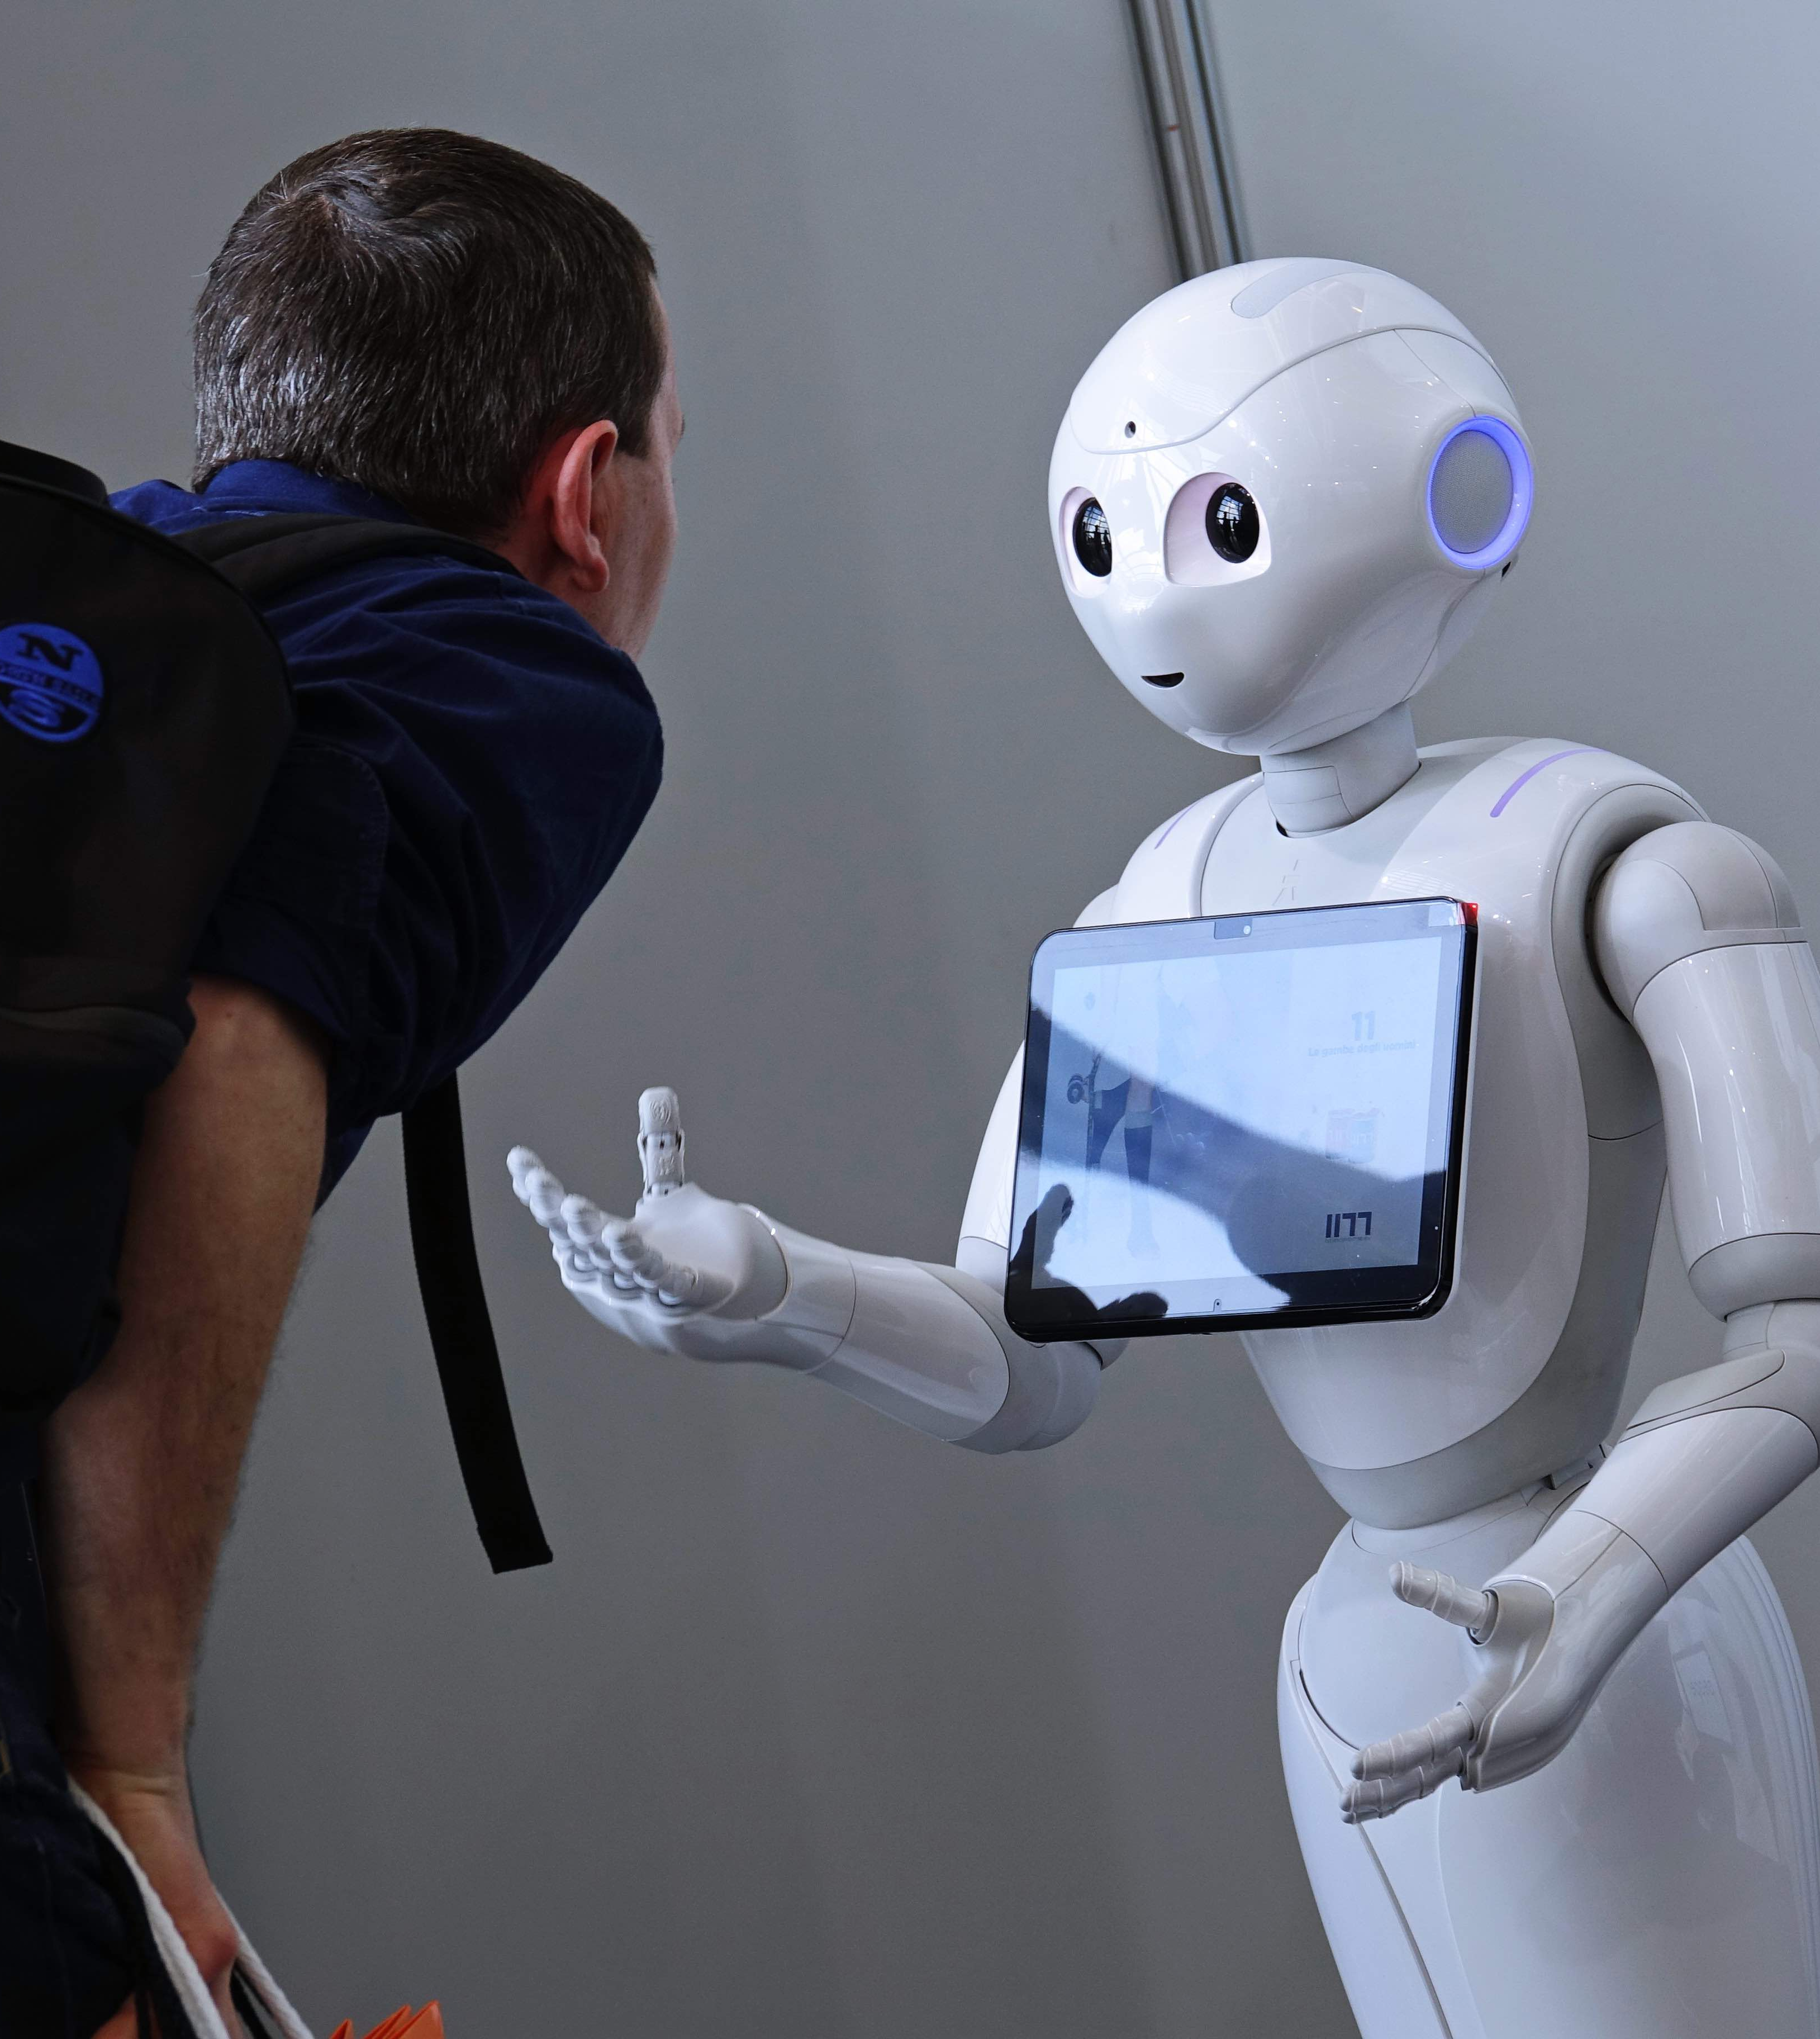
Computer Vision (CV)
CV focuses on enabling computers to extract information and identify objects from images and videos, in a manner like human vision.

Slide 3
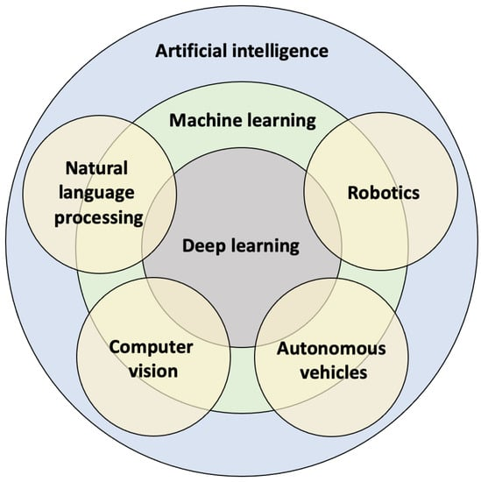
Computer Vision (CV)
CV is a field of study within artificial intelligence (AI).

Slide 4
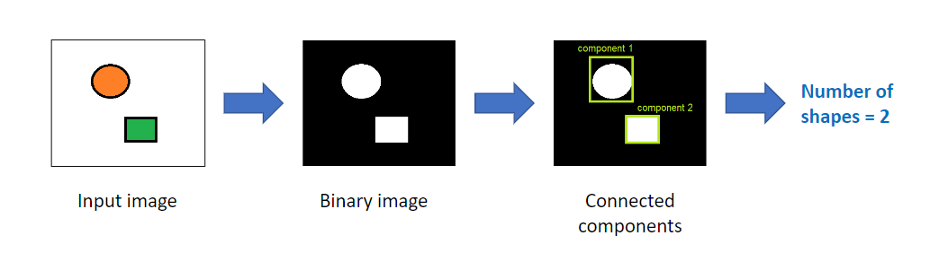
Computer vision techniques
Image Processing

Slide 5
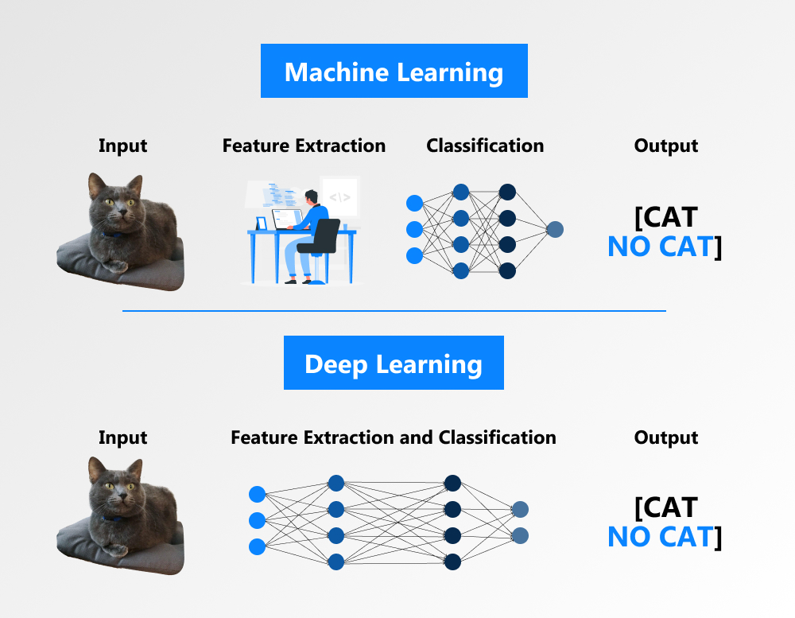
Computer vision techniques
Feature extraction + Machine Learning
Data vector

Slide 6
Computer vision techniques
Deep Learning

Slide 7
Machine Leaning VS Deep Learning
Data vector
Machine Leaning
Deep Learning

Slide 8
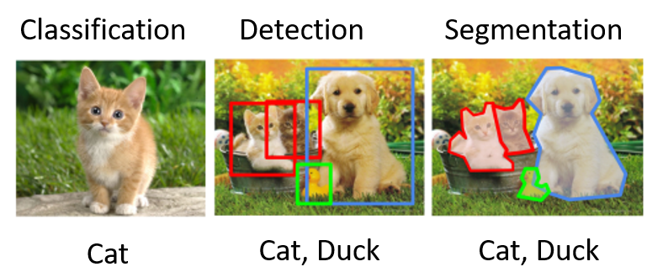
Computer vision fields
1. Image Classification
2. Object detection
3. Image segmentation

Slide 9
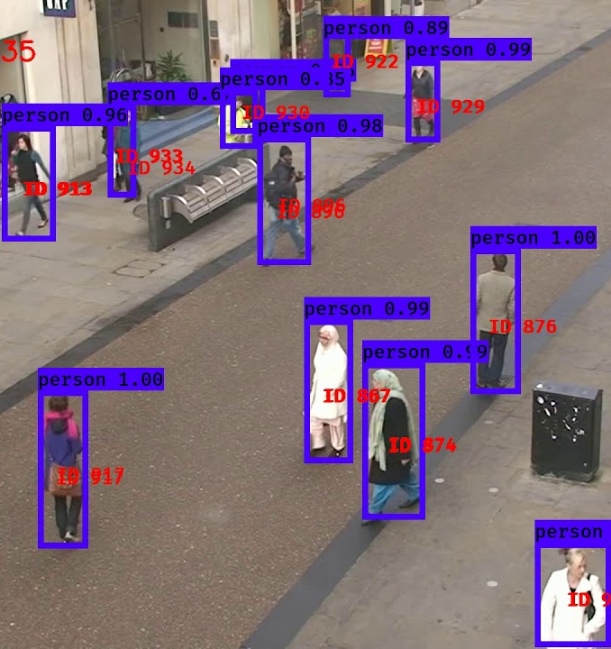
Computer vision fields
Tracking

Slide 10
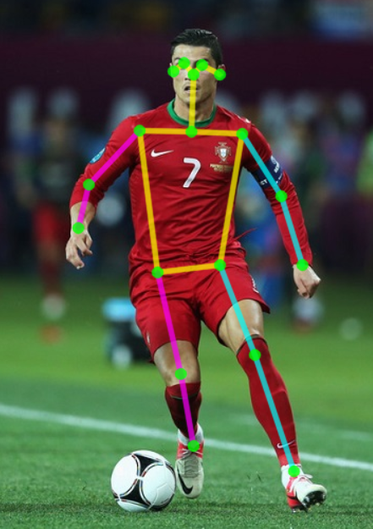
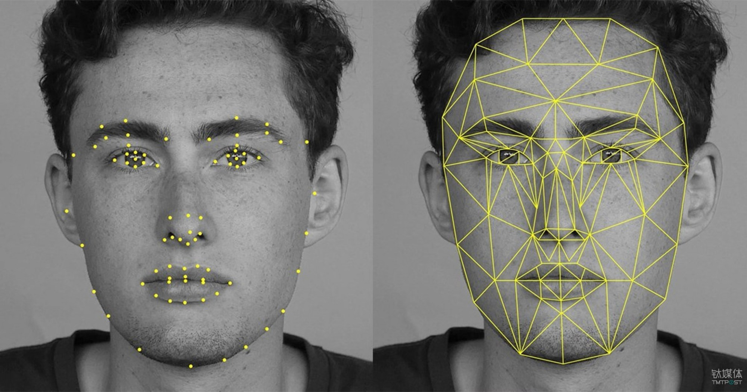
Computer vision fields
Pose Estimation

Slide 11
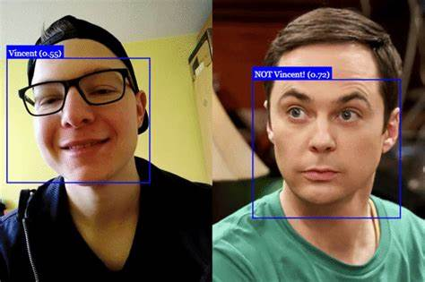
Computer vision fields
Face Detection
Face recognition

Slide 12
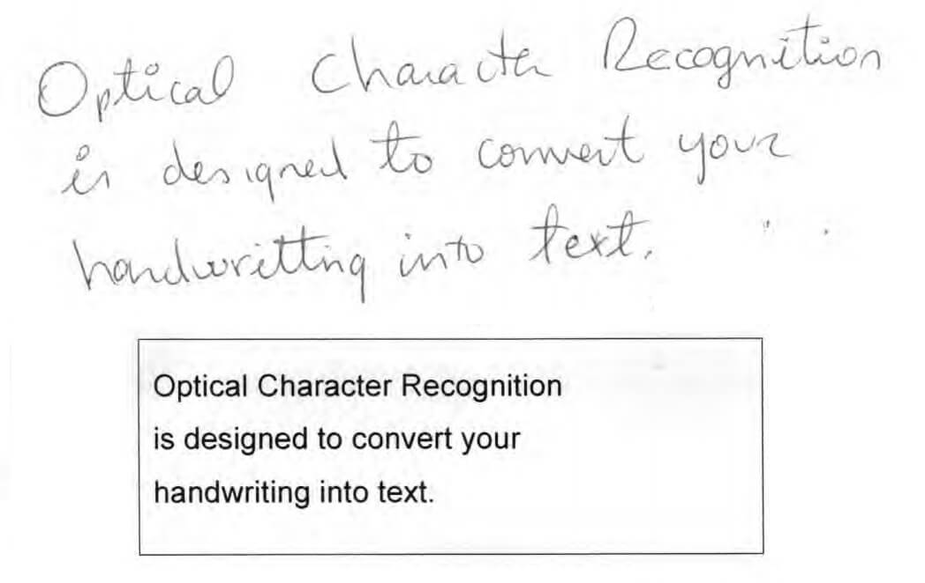
Computer vision fields
Optical Character Recognition

Slide 13
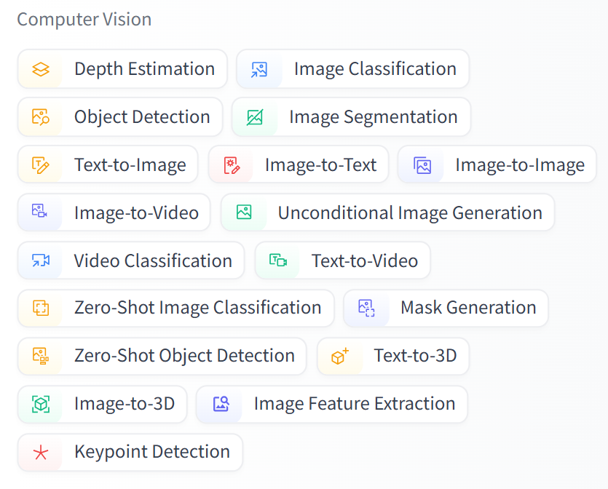
Computer vision fields
Advanced techniques in CV [Hugging Face 🤗,diffuser]
huggingface/diffusers: 🤗 Diffusers: State-of-the-art diffusion models for image and audio generation in PyTorch and FLAX. (github.com)
Models - Hugging Face

Slide 14

Anaconda
Download from here: https://www.anaconda.com/download

Slide 15



OpenCV
OpenCV (Open-Source Computer Vision Library) is a library of programming functions mainly for real-time computer vision.
Download from here: https://pypi.org/project/opencv-python/
pip install opencv-python
Documentation: OpenCV - Open Computer Vision Library

Slide 16
Simple OpenCV Example
import cv2
img = cv2.imread("image.jpg")
gray = cv2.cvtColor(img, cv2.COLOR_BGR2GRAY)
cv2.imshow("Gray Image", gray)
cv2.waitKey(0)
cv2.destroyAllWindows()

Slide 17
OpenCV Applications
Healthcare
Manufacturing
Agriculture
Smart cities
E-commerce
AR/VR

